Slide 1
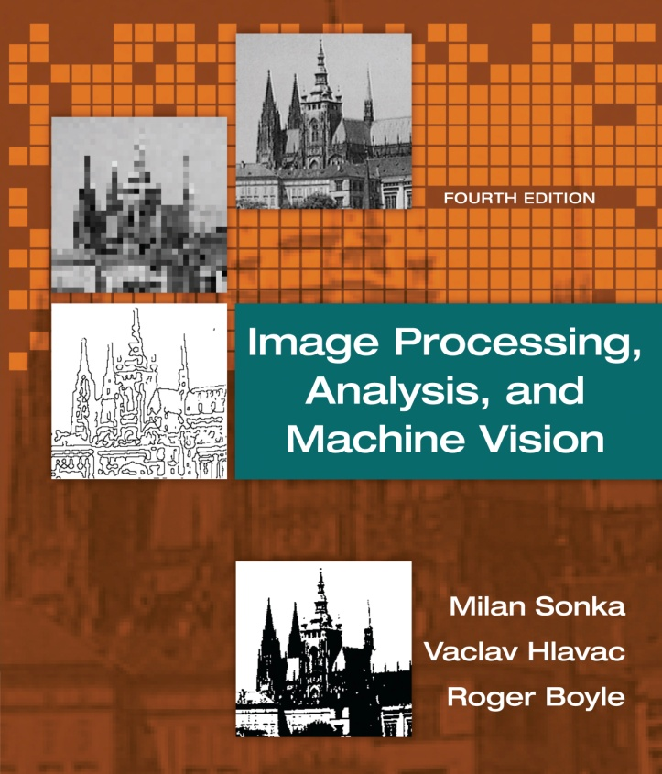

Chapter 3
Image Processing, Analysis, and Machine Vision, 4th Edition Sonka, Hlavac & Boyle
The image, its mathematical and physical background

Slide 2
Outline
Image Processing, Analysis, and Machine Vision, 4th Edition Sonka, Hlavac & Boyle
Overview
Linear integral transforms
Images as linear systems
Introduction to linear integral transforms
Fourier transform
Sampling and the Shannon constraint
Wavelet transform
Images as stochastic process
Image formation physics

Slide 3
Wavelet transform
Image Processing, Analysis, and Machine Vision, 4th Edition Sonka, Hlavac & Boyle
The disadvantage of Fourier transform
The Fourier spectrum provides all the frequencies present in an image but does not tell where they are present.
One solution to the problem of localizing changes in the image is to use the short time Fourier transform, where the signal is divided into small windows and treated locally as it were periodic.
Window dilemma
A narrow window yields poor frequency resolution
A wide window provides poor localization
Another method: Wavelet transform

Slide 4
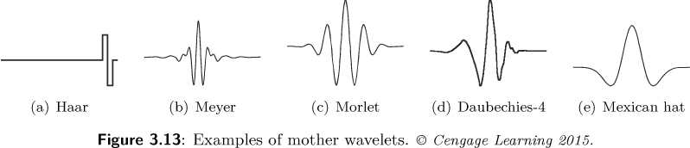
Wavelet transform
Image Processing, Analysis, and Machine Vision, 4th Edition Sonka, Hlavac & Boyle
The wavelet transform analyzes the signal by multiplying it by a window function and performing an orthogonal expansion.
There are two directions in which the analysis is extended.
In the first direction
The based functions (wavelets) provide localization in space to a certain degree.
Five commonly used mother wavelets are shown in Figure 3.13.
In the second direction
The analysis is performed at multiple scales.
Wavelet: wave that is only nonzero in a small region

Slide 5
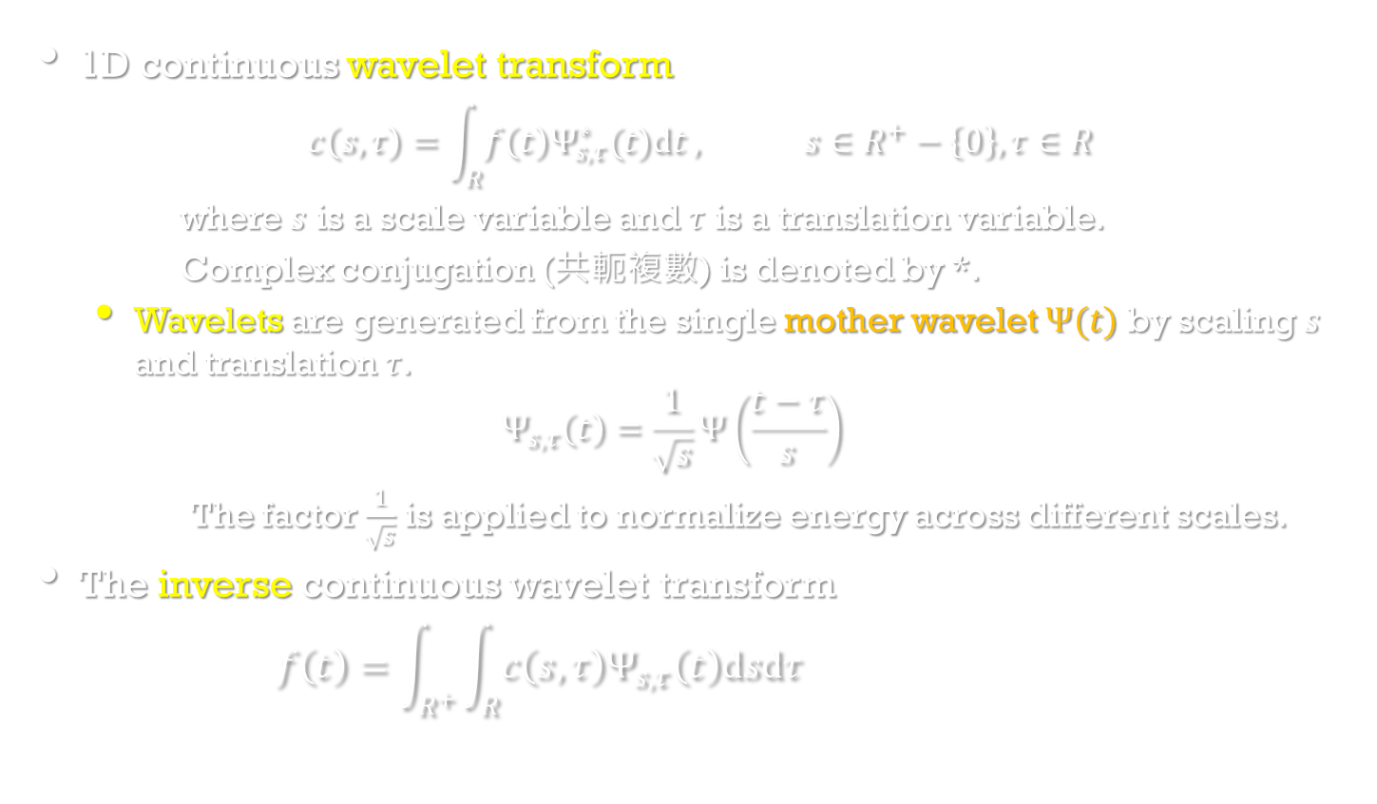
Wavelet transform
Image Processing, Analysis, and Machine Vision, 4th Edition Sonka, Hlavac & Boyle
1D continuous wavelet transform
$$c\left(s,τ\right)=\int_{R}^{ }{f\left(t\right)Ψ_{s,τ}^{∗}(t)dt}, s∈R^{+}−\left\{0\right\},τ∈R$$
where $s$ is a scale variable and $τ$ is a translation variable.
Complex conjugation (共軛複數) is denoted by *.
Wavelets are generated from the single mother wavelet $Ψ(t)$ by scaling $s$ and translation $τ$.
$$Ψ_{s,τ}\left(t\right)=\frac{1}{\sqrt{s}}Ψ\left(\frac{t−τ}{s}\right)$$
The factor $\frac{1}{\sqrt{s}}$ is applied to normalize energy across different scales.
The inverse continuous wavelet transform
$$f\left(t\right)=\int_{R^{+}}^{ }{\int_{R}^{ }{c\left(s,τ\right)Ψ_{s,τ}\left(t\right)dsdτ}}$$

Slide 6
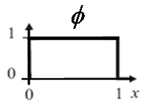
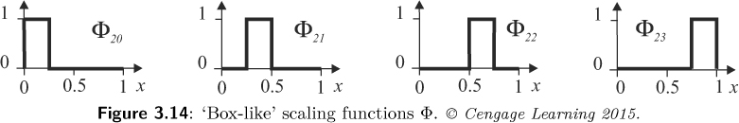
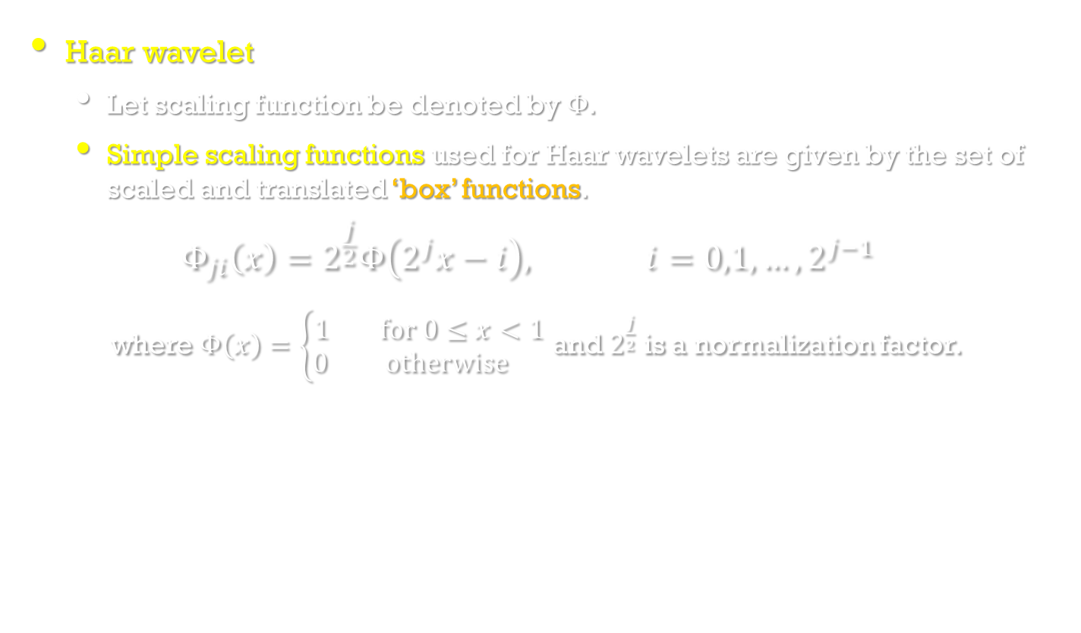
Wavelet transform
Image Processing, Analysis, and Machine Vision, 4th Edition Sonka, Hlavac & Boyle
Haar wavelet
Let scaling function be denoted by $Φ$.
Simple scaling functions used for Haar wavelets are given by the set of scaled and translated ‘box’ functions.
$$Φ_{ji}\left(x\right)=2^{\frac{j}{2}}Φ\left(2^{j}x−i\right), i=0,1,…,2^{j−1}$$
where $Φ\left(x\right)=\left\{\begin{matrix}1 for 0≤x<1 \\ 0 otherwise \end{matrix}\right.$ and $2^{\frac{j}{2}}$ is a normalization factor.
2
2
2
2

Slide 7
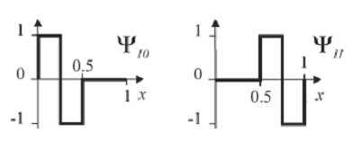
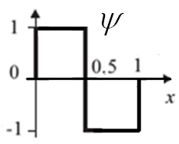


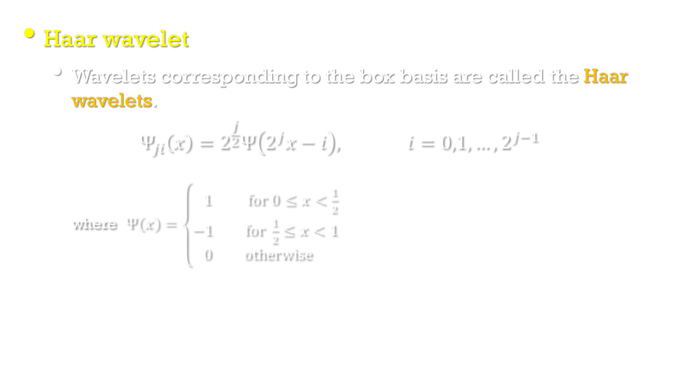


Wavelet transform
Image Processing, Analysis, and Machine Vision, 4th Edition Sonka, Hlavac & Boyle
Haar wavelet
Wavelets corresponding to the box basis are called the Haar wavelets.
$$Ψ_{ji}\left(x\right)=2^{\frac{j}{2}}Ψ\left(2^{j}x−i\right), i=0,1,…,2^{j−1}$$
where $Ψ\left(x\right)=\left\{\begin{matrix} 1 for 0≤x<\frac{1}{2} \\ −1 for \frac{1}{2}≤x<1 \\ 0 otherwise \end{matrix}\right.$
$$\sqrt{2}$$
$$\sqrt{2}$$
$$−\sqrt{2}$$
$$−\sqrt{2}$$

Slide 8
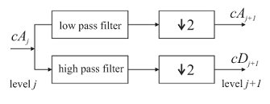
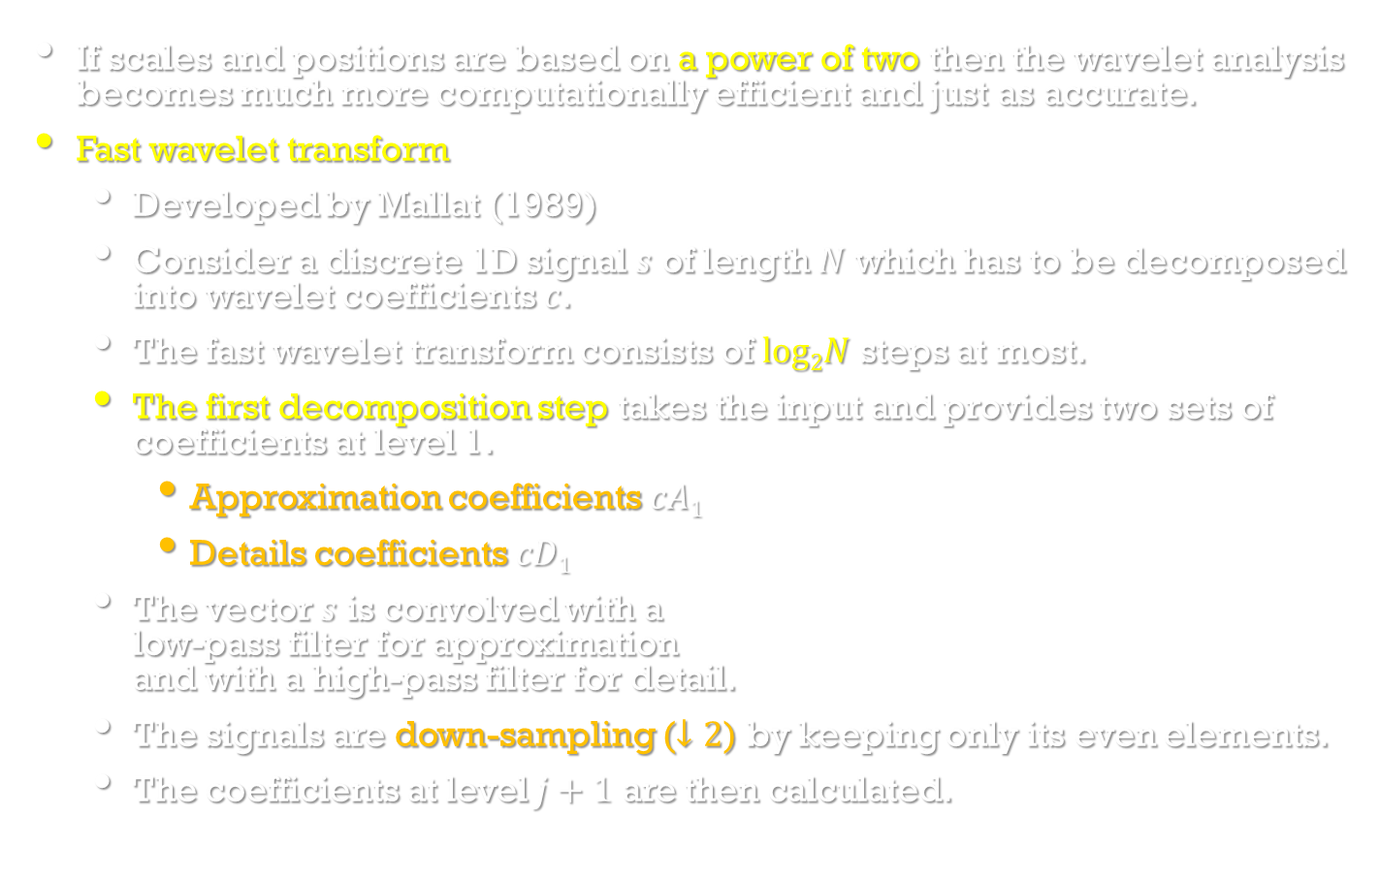
Discrete wavelet transform
Image Processing, Analysis, and Machine Vision, 4th Edition Sonka, Hlavac & Boyle
If scales and positions are based on a power of two then the wavelet analysis becomes much more computationally efficient and just as accurate.
Fast wavelet transform
Developed by Mallat (1989)
Consider a discrete 1D signal $s$ of length $N$ which has to be decomposed into wavelet coefficients $c$.
The fast wavelet transform consists of $log2N$ steps at most.
The first decomposition step takes the input and provides two sets of coefficients at level 1.
Approximation coefficients $cA1$
Details coefficients $cD1$
The vector $s$ is convolved with a low-pass filter for approximation and with a high-pass filter for detail.
The signals are down-sampling ($↓2$) by keeping only its even elements.
The coefficients at level $j+1$ are then calculated.

Slide 9
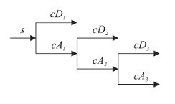
Discrete wavelet transform
Image Processing, Analysis, and Machine Vision, 4th Edition Sonka, Hlavac & Boyle
Fast wavelet transform (con.)
The above procedure is repeated recursively to obtain approximation and detail coefficients at further levels.

Slide 10
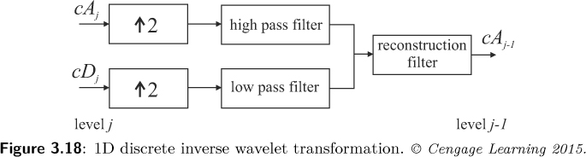
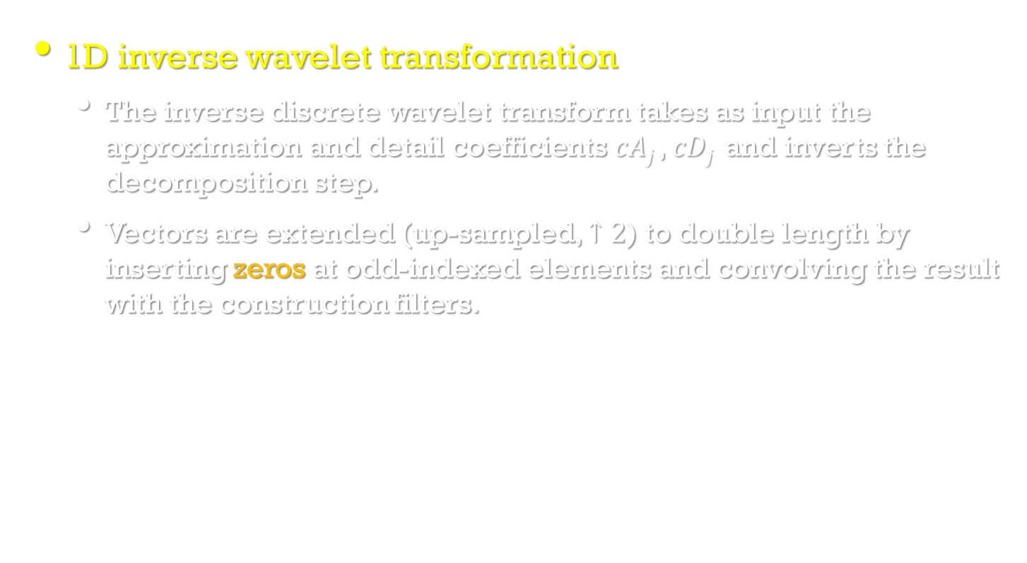
Discrete wavelet transform
Image Processing, Analysis, and Machine Vision, 4th Edition Sonka, Hlavac & Boyle
1D inverse wavelet transformation
The inverse discrete wavelet transform takes as input the approximation and detail coefficients $cAj$, $cDj$ and inverts the decomposition step.
Vectors are extended (up-sampled, $↑2$) to double length by inserting zeros at odd-indexed elements and convolving the result with the construction filters.

Slide 11
○ Wavelet transforms
Low pass filtering: averaging
High pass filtering: differencing
Input data: a, b
Average: s = (a + b) / 2 (low pass filtering)
Difference: d = a – s (high pass filtering)
Wavelet coefficients: (s, d).
○ Inverse wavelet transforms
Addition; subtraction
Wavelet coefficients: (s, d).
Addition: s + d = s + (a – s) = a,
Subtraction: s – d = s – (a – s) = 2s – a = b
Input data: (a, b).

Slide 12
。Example 1:
Input data 14, 22
(i) Wavelet Transform
Average: s = (14＋22)/2 = 18,
Difference: d = 14 − 18= −4
Wavelet coefficients: (18, − 4).
(ii) Inverse Wavelet Transform (to recover the input data)
s ＋ d = 18+(− 4) = 14,
s − d = 18−(− 4) = 22
Input data: (14, 22).

Slide 13
。Example 2:
Input vector: v = [38 74 12 56]
Average vector: s1 = [(38+74)/2 (12+56)/2] = [56 34]
Difference vector: d1 = [38−56 12−34] = [−18 −22]
Wavelet transform at 1 scale:
v1 = [ s1 d1 ] = [56 34 −18 −22]
Average vector: s2 = [(56+34)/2] = [45]
Difference vector: d2 = [56 − 45] = [11]
Wavelet transform at 2 scale:
v2 = [ s2 d2 d1 ] = [45 11 −18 −22]
Recover the original input signal
From v2 = [ s2 d2 d1 ] = [45 11 −18 −22]
[45+11 45−11 −18 −22] = [56 34 −18 −22]
Inverse wavelet transform results:
[56+(−18) 56−(−18) 34+(−22) 34−(−22)] = [38 74 12 56]

Slide 14
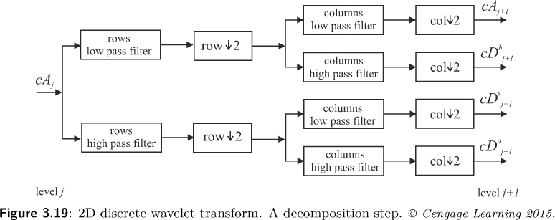

Discrete wavelet transform
Image Processing, Analysis, and Machine Vision, 4th Edition Sonka, Hlavac & Boyle
2D discrete wavelet transform
The symbol (row$↓2$) means down-sampling rows by keeping only evenly indexed rows.

Slide 15
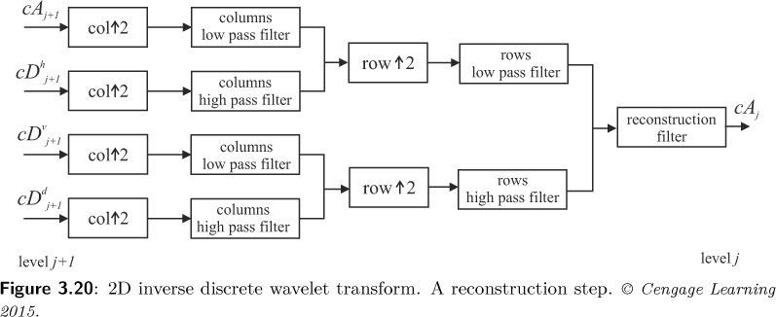

Discrete wavelet transform
Image Processing, Analysis, and Machine Vision, 4th Edition Sonka, Hlavac & Boyle
2D inverse wavelet transform
The symbol (row$↑2$) means up-sampling rows by inserting zeros at odd-indexed rows.

Slide 16
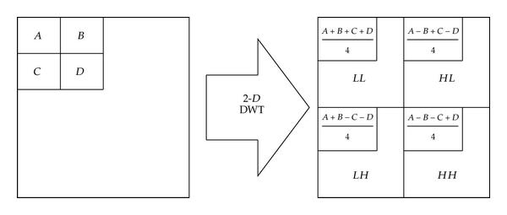
2D Haar Wavelet transform
https://zh.wikipedia.org/wiki/%E9%9B%A2%E6%95%A3%E5%B0%8F%E6%B3%A2%E8%AE%8A%E6%8F%9B

Slide 17
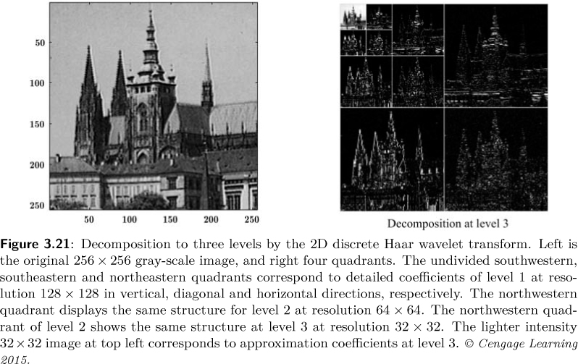
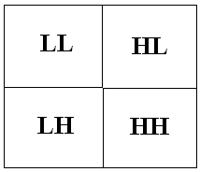
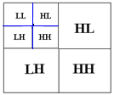
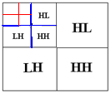




Discrete wavelet transform
Image Processing, Analysis, and Machine Vision, 4th Edition Sonka, Hlavac & Boyle
An example of 2D discrete wavelet transform
$$cA$$
$$cD^{h}$$
$$cD^{v}$$
$$cD^{d}$$

Slide 18
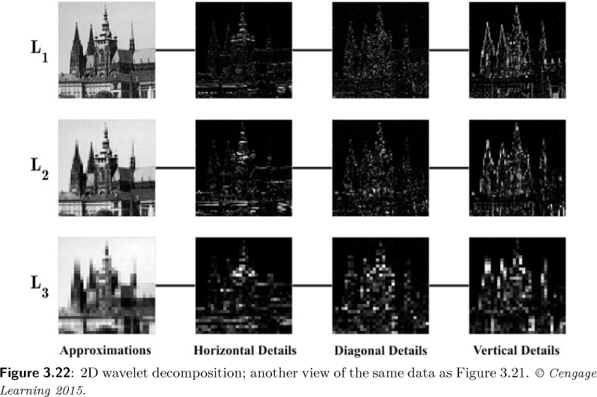




Discrete wavelet transform
Image Processing, Analysis, and Machine Vision, 4th Edition Sonka, Hlavac & Boyle
$$cA$$
$$cD^{h}$$
$$cD^{d}$$
$$cD^{v}$$

Slide 19
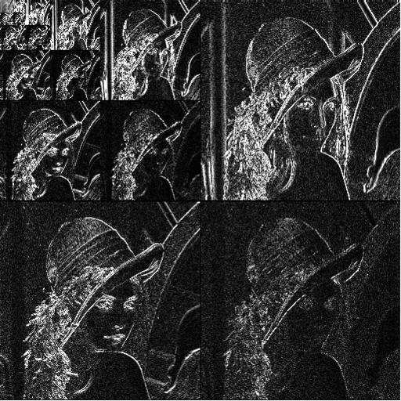
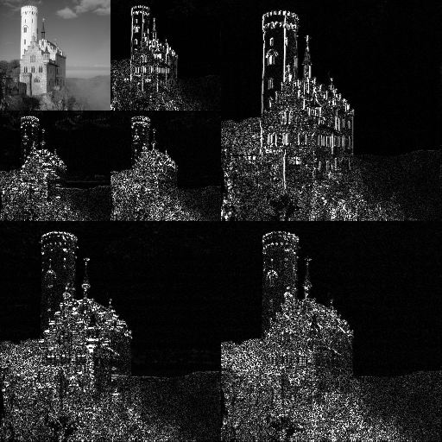
Discrete wavelet transform
https://www.researchgate.net/figure/The-Lena-images-decomposed-by-square-and-rectangular-wavelet-transforms-based-on-the-Haar_fig1_1957226

Slide 20
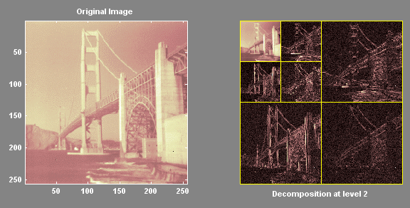
Discrete wavelet transform
http://user.engineering.uiowa.edu/~dip/lecture/LinTransforms.html

